Slide 1
Support Vector Machines - Part 1
UIUC ECON 490: Applied Machine Learning in Economics

Slide 2
A “Super Versatile Model”
SVMs applications:
Classification
Regression
Outlier detection
Thrives in:
Complex data sets
Small- to medium-sized data sets
Computationally expensive
Today
Maximal Margin Classifier
Support Vector Classifier
Classification with two classes

Slide 3
Maximal Margin Classifier (MMC)
The Widest Street

Slide 4
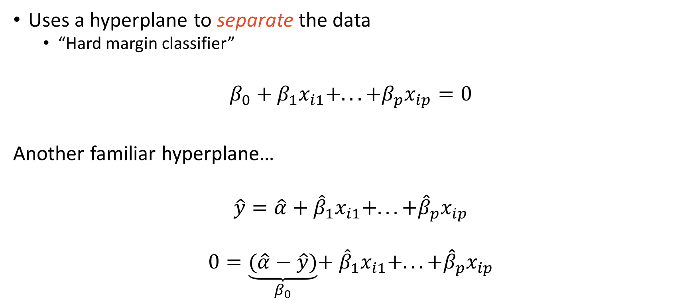
Maximal Margin Classifier Decision Boundaries
Uses a hyperplane to separate the data
“Hard margin classifier”
$$β_{0}+β_{1}x_{i1}+...+β_{p}x_{ip}=0$$
Another familiar hyperplane…
$$\hat{y}=\hat{α}+{\hat{β}}_{1}x_{i1}+...+{\hat{β}}_{p}x_{ip}$$
$$0=\underset{β_{0}}{\underbrace{(\hat{α}−\hat{y})}}+{\hat{β}}_{1}x_{i1}+...+{\hat{β}}_{p}x_{ip}$$

Slide 5
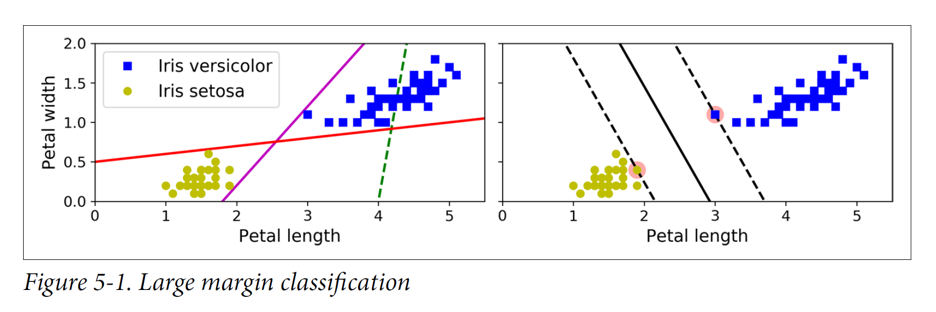
Fitting the “Widest Street”

Slide 6
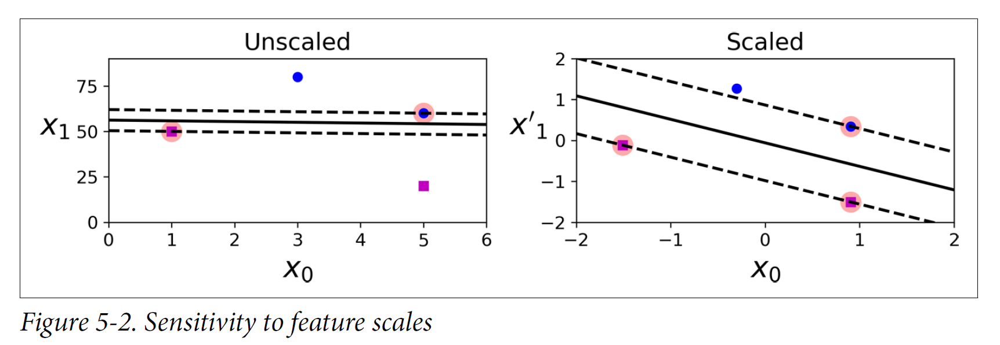
Scale Matters!

Slide 7
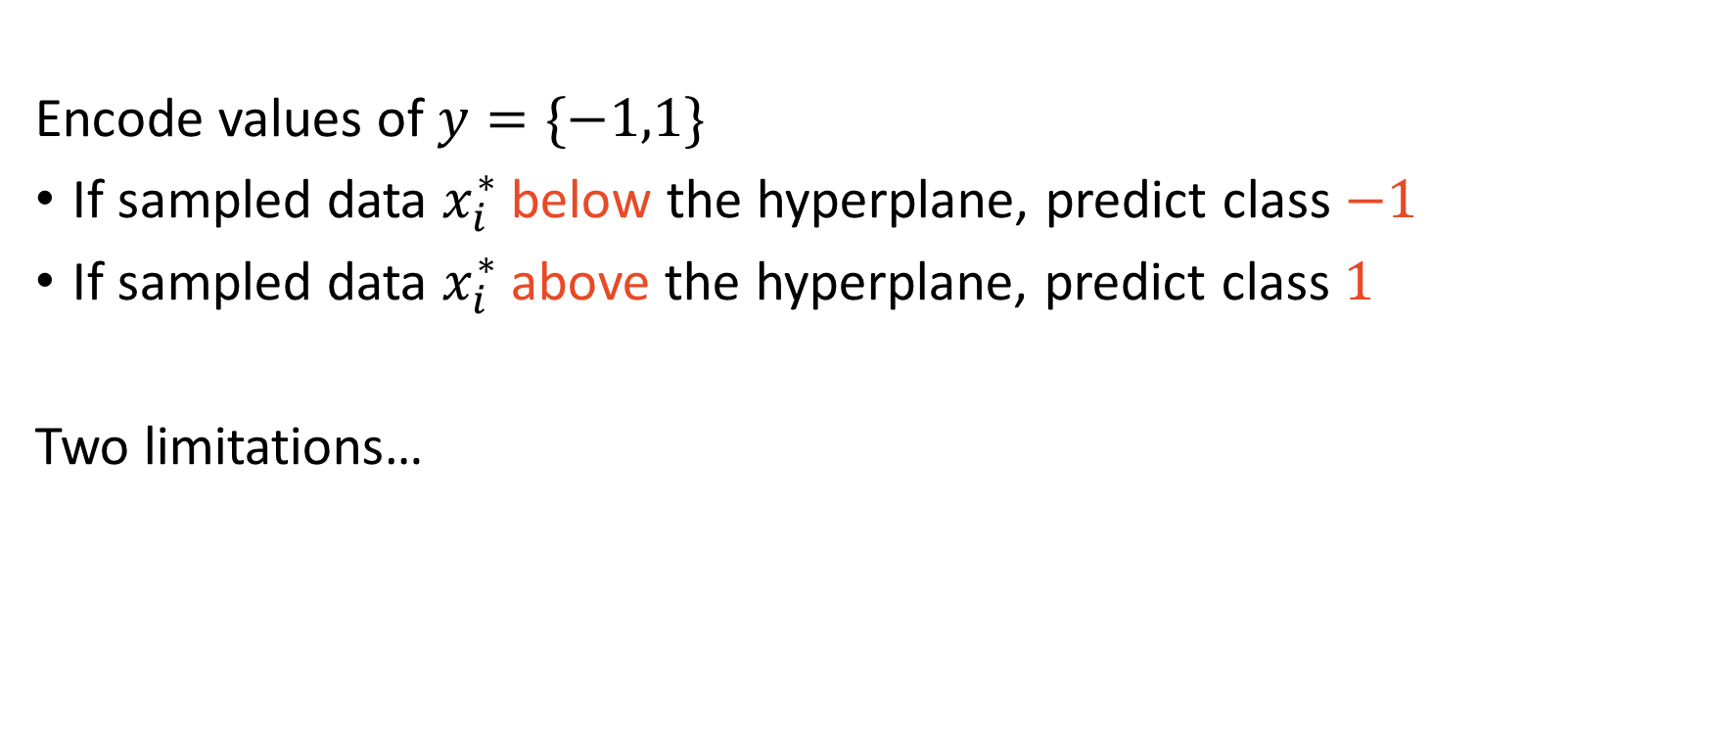
MMC – Under the hood
Encode values of $y=\{−1,1\}$
If sampled data $x_{i}^{∗}$ below the hyperplane, predict class $−1$
If sampled data $x_{i}^{∗}$ above the hyperplane, predict class $1$
Two limitations…

Slide 8
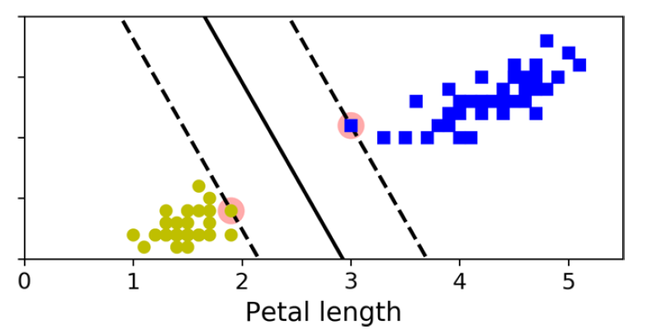
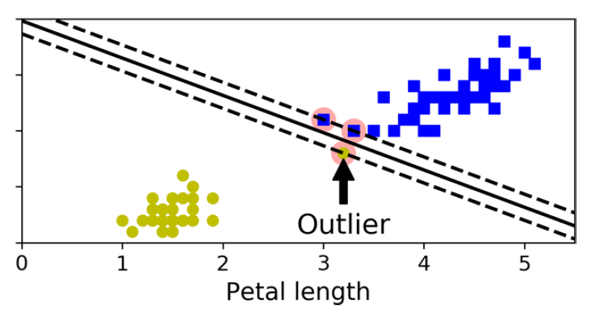
Sensitive to Outliers!

Slide 9
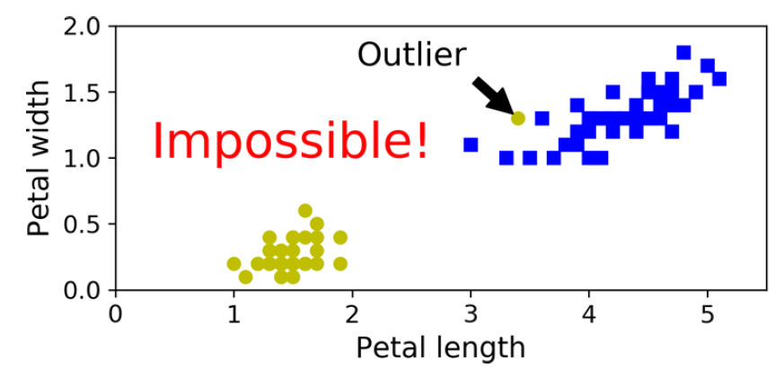
Cannot Fit Non-Separable Data

Slide 10
Support Vector Classifier
Soft Margin Classifier

Slide 11
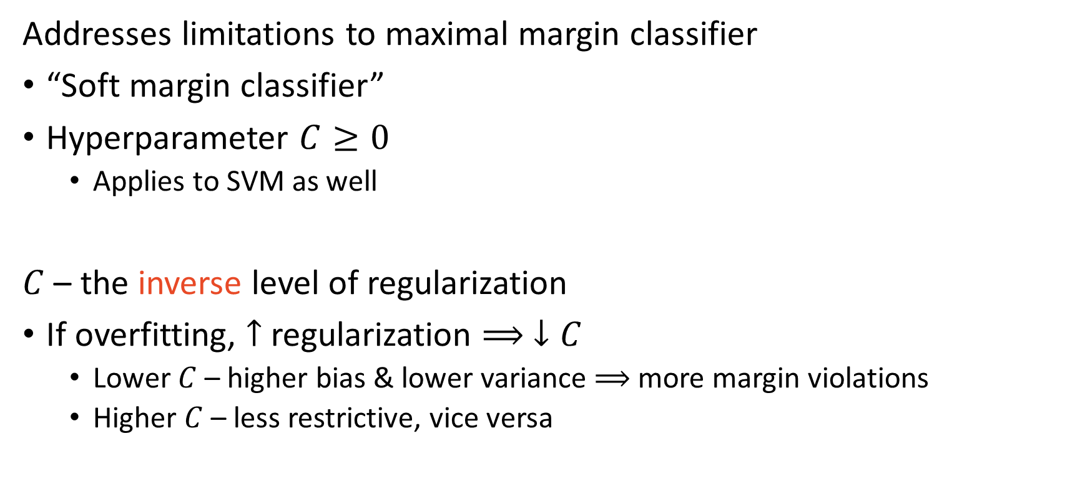
Support Vector Classifier
Addresses limitations to maximal margin classifier
“Soft margin classifier”
Hyperparameter $C≥0$
Applies to SVM as well
$C$ – the inverse level of regularization
If overfitting, $↑$ regularization $⟹ ↓C$
Lower $C$ – higher bias & lower variance $⟹$ more margin violations
Higher $C$ – less restrictive, vice versa

Slide 12
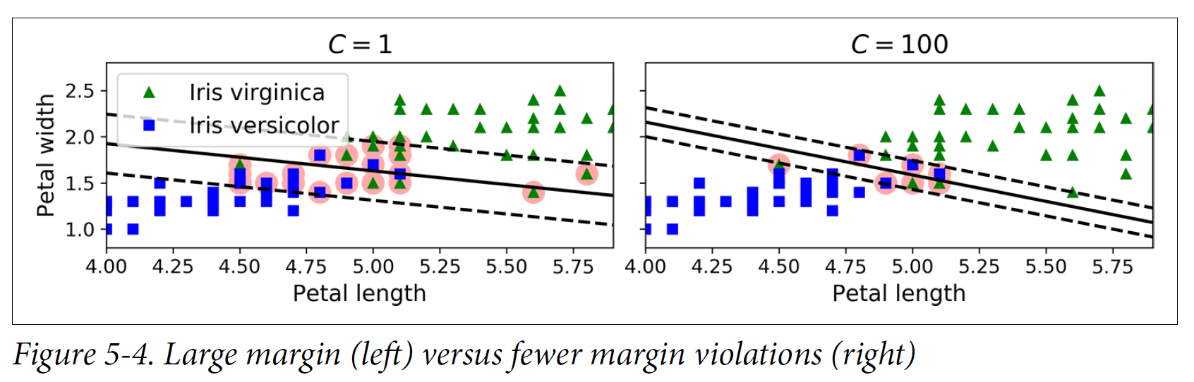
Visual Margin Violations

Slide 13
How to determine $C$?
Cross-validation!!
What is CV doing?
Finding a finite sample “optimum” balance of the BV tradeoff

Slide 14
Implementation – Scikit-learn
sklearn.svm.LinearSVC()
Important parameters
C: inverse regularization strength
dual: Set “False” if # obs > # features

Slide 15

Takeaways – SVM1
SVMs main idea: widest street
Widest street $⟹$ distance $⟹$ standardize
C: level of crankiness from margin violations
Crankier $⟹$ fewer violations

